Slide 1
Tutorial: Gigabit Ethernet Over Plastic Optical Fiber (GEPOF)
IEEE 802 plenary session
3 November 2014

Slide 2
Panel
Bob Grow, GEPOF SG Chair, RMG Consulting
Carlos Pardo, KDPOF
Naoshi Serizawa, Yazaki Corporation
Thomas Lichtenegger, Avago Technologies

Slide 3
Outline
Overview of proposed p802.3bv project
Technical / Economic Feasibility
Home networking market
Automotive market
Industrial market
Support
Summary and questions

Slide 4
Overview of proposed p802.3bv project
Objectives
History of Previous Ethernet Over POF Activities
VDE standard development

Slide 5
Objectives
Preserve the IEEE 802.3/Ethernet frame format utilizing the IEEE 802.3 MAC
Preserve minimum and maximum frame size of the current IEEE 802.3 standard
Support full duplex operation only
Support a data rate of 1000 Mb/s at the MAC/PLS service interface
For the automotive environment:
Specify operation over at least 15m of POF with 4 POF connections
Specify operation over at least 40m of POF with no POF connections
For the home and industrial environment specify operation over at least 50m of POF with 1 POF connection
Maintain a bit error ratio (BER) better than or equal to 10⁻¹² at the MAC/PLS service interface
Specify optional Energy-Efficient Ethernet for 1000 Mb/s over POF

Slide 6
History of Previous Ethernet Over POF Activities
An Ethernet PHY project was initiated in VDE (Verband der Elektrotechnik Elektronik Informationstechnik)
Issues with the VDE document were raised by IEEE-SA
Changes to draft requested
It was also noted that such work appropriately belongs in IEEE 802.3
VDE choose to withdraw the document
Participants want to do the work in IEEE 802.3

Slide 7
VDE standard development
VDE standardization was being driven by:
Siemens, Avago, Phoneix Contact, Firecomms, Franhoufer Institute, POF-Application Center, Innodul, Teleconnect, Diemount, KDPOF, …
Multiple technical proposals considered:
Modulation: NRZ, PAM-4, OFDM, PAM-16
Coding: Reed Solomon, MLCC, BCH, LDPC
Technical solutions adopted and specified in the VDE document

Slide 8
Technical and Economic Feasibility
Introduction to POF
Introduction to light transmitter and receiver
Connections
Length objectives
How is the VDE proposal?
Tradeoffs
Non linearity
Performance of the VDE standard

Slide 9
Introduction to POF
Typical optical fibers
GEPOF target
SI - Step-Index
1mm SI-POF multimode NA 0.5
core: ⌀ 8 μm
clad: ⌀ 125 μm
SM-GOF for long-distance transmission
GI - Graded-Index
core: ⌀ 980 μm
clad: ⌀ 1000 μm
core: ⌀ 50 or 62.5 μm
clad: ⌀ 125 μm
MM-GOF for data-centers, office-LAN

Slide 10
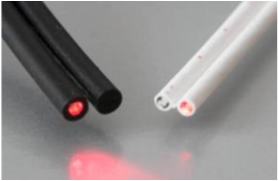
Introduction to POF
The Plastic Optical Fiber is made of 1mm PMMA
Proposed POF is Step Index (SI-POF) according to: IEC 60793-2-40 .ed.3:2009: Type A4a.2
< 18 dB/100m if equilibrium mode distribution launch
Optical bandwidth > 40 MHz at 100m
Negligible temperature dependence
Different jacketing available for various applications
Dual fiber full duplex operation

Slide 11
Light transmission in SI-POF
Area of higher attenuation
that produces differential mode att.
Angle of rays in respect fiber axis is
intrinsically related to TEM mode
in step-index fibers
Optische Nachrichtentechnik:: Olaf Ziemann
Mode mixing
Differential mode delay
Relative mode delay

Slide 12
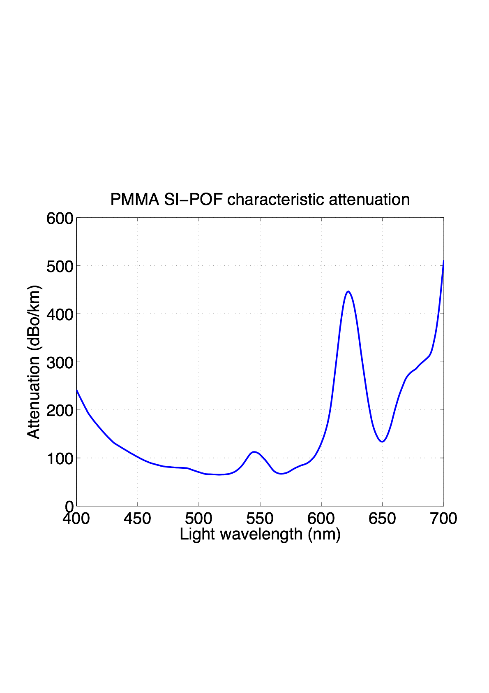
Introduction to POF
Obtained with laser collimated light source
Notes:
Important to note 650 nm valley and low attenuation in green for future

Slide 13
Introduction to POF - mode mixing
POF has a big mode mixing effect
Bending and length brings the launching mode distribution into the Equilibrium Mode Distribution (EMD)
Bandwidth·sqrt (Length) Product and Attenuation/Length approximate constants in EMD
Typically, light sources are manufactured to launch almost EMD to have predictable performance and avoid excessive mode conversion in bends
Discontinuities and impurities
of PMMA speed up mode mixing
Optische Nachrichtentechnik:: Olaf Ziemann
Irregularities in the core-clad
boundary also ease mode mixing

Slide 14
Bending
Optische Nachrichtentechnik:: Olaf Ziemann

Slide 15
Bending
During bending the mode distribution changes
Different mode distributions represents different channel responses in terms of bandwidth and attenuation
Dynamic bending requires continuous equalization of the channel response
There are backup slides with detailed technical description of the optical channel

Slide 16
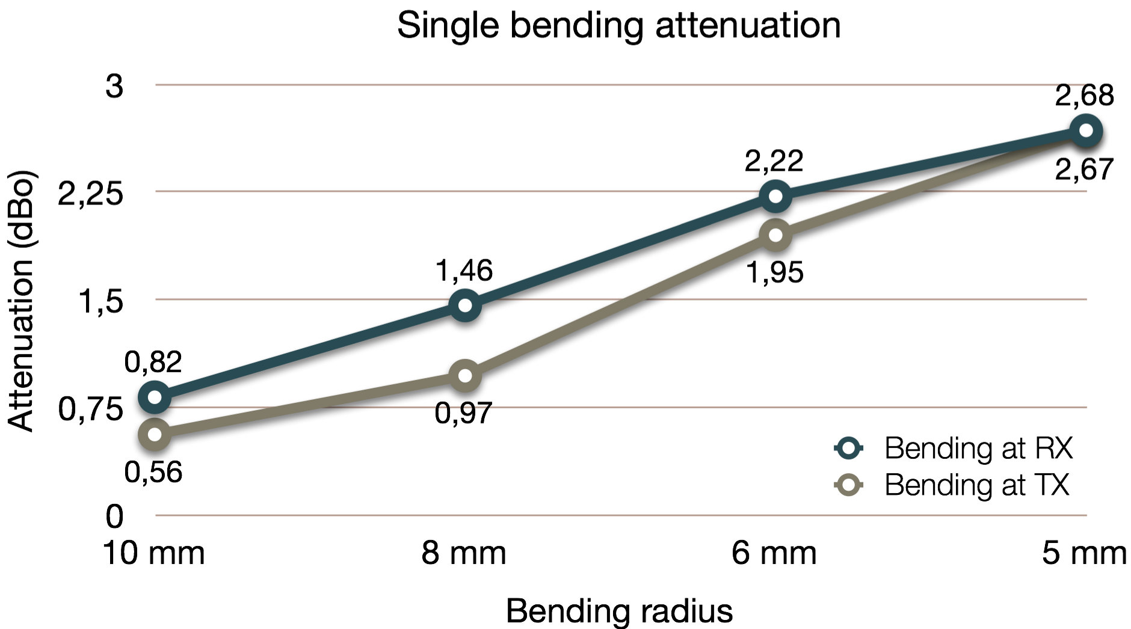
Bending effects
Down to 5 mm. No losses at 25 mm bending radius (Automotive)
Bending reduce optical power, and destroy higher modes improving bandwidth
Objectives can be reached even with bending

Slide 17

LED light source
650 nm (red) LED
Qualified for automotive up to 95ºC (HTOL 3000 h)
105ºC Automotive feasibility demonstrated
AOP: Average optical power coupled into fiber
Linearity
-20 / -30 dBc typical. (2nd / 3rd harmonic distortion). Varies with temperature and manufacturer
Bandwidth (E to E @ -3 dB): Typically 75Mhz. Improved with driver pre-emphasis up to 150 MHz
Different launch condition depending on the manufacturer. After lens the launch Numerical Aperture is approximately 0.3
Temp | -40ºC | 0ºC | 20ºC | 70ºC | 85ºC | 95ºC | 105ºC
AOP | -1.8 dBm | -2.5 dBm | -3.0 dBm | -5.2 dBm | -5.8 dBm | -7.0 dBm | -7.5 dBm

Slide 18


Receiver
Si-PIN Photo Diode(PD) is normally used
400 um -> 600 um PD diameter
Both, PD pseudo-differential and PD single ended solutions are available
Might be embedded with TIA (Trans Impedance Amplifier) to reduce EMS (Electro Magnetic Susceptibility)
Low dependency of response with temperature
TIA bandwidth and noise depends on received power

Slide 19
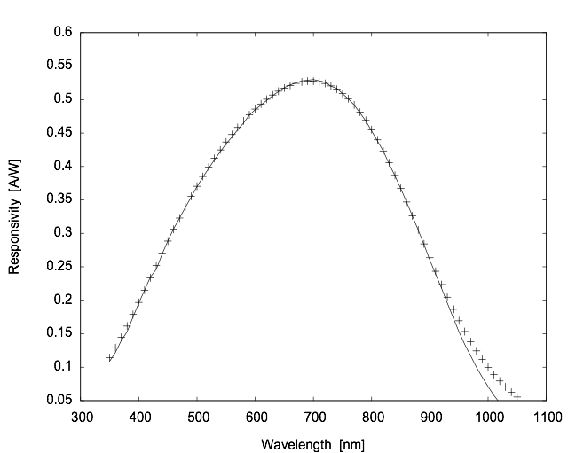
PD Responsitivity

Slide 20
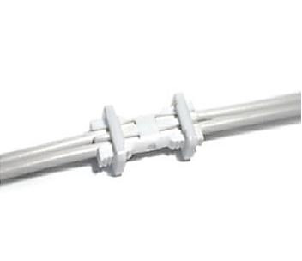
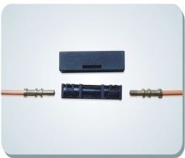
Connections (In-line connector)
From 1.0 dB to 2.5 dB attenuation
No real impact on bandwidth

Slide 21
Length objectives consider application temperature & connection requirements
Root cause: LED AOP decrease with increased temperature
Automotive (-40ºC to +105ºC):
15 m with 4 connections
40 m no connections
Industrial and Home Networking (-20ºC to 85ºC):
50 m with 1 connection
All three length objectives can be met with a single PHY specification

Slide 22
VDE proposal
Provided to 802.3 as a contribution
Economical and technical feasibility
SG has not adopted technical proposals
PAM-16 with THP (312.5 Mbaud)
Optimum solution for current LED, Fibre and PD and feasible TIA
THP is used to:
Solve Inter Symbol Interference (ISI) in combination with high spectral efficiency coded modulation
Allows whitening of TIA non-white noise
Notes:
Need to acknowledge that graphs are unreadable, explain green line and axis and what curve means if kept.

Slide 23
Sensitivity based on Shannon capacity
Increase
Attenuation
Info Source
Encoder
DAC
Driver + LED
POF
Variable Attenuator
Photo-diode
Measure
Sensitivity
(min power)
BER Tester
M-PAM
ENOB
FS
Info Sink
Decoder
Equalizer
ADC
Antialias Filter
TIA
While keeping
BER < 10⁻¹²
M-PAM
Coding
gain
ENOB
FS
Type
Fc

Slide 24
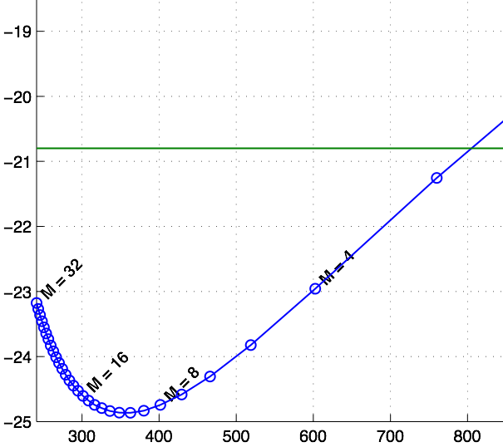
Sensitivity for 15m + 4 connections
Sensitivity as function of M levels of PAM
Target by link budget analysis
Sensitivity (dBm)
Symbol rate (MHz)

Slide 25
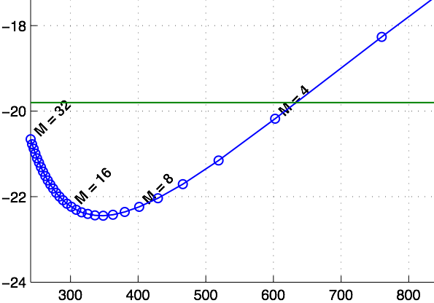
Sensitivity for 50m + 1 connections
Sensitivity as function of M levels of PAM
Target by link budget analysis
Sensitivity (dBm)
Symbol rate (MHz)
25

Slide 26
VDE data encapsulation
Periodic transmission structure
To have a fast link establishment (Less than 50 ms)
To have big tolerance to clock frequency mismatch (>+-200 ppm)
To have a fast negotiation of THP TX coefficients
To track and equalize channel changes with temperature, bending and vibration
To implement Low Power Idle mode (EEE)

Slide 27
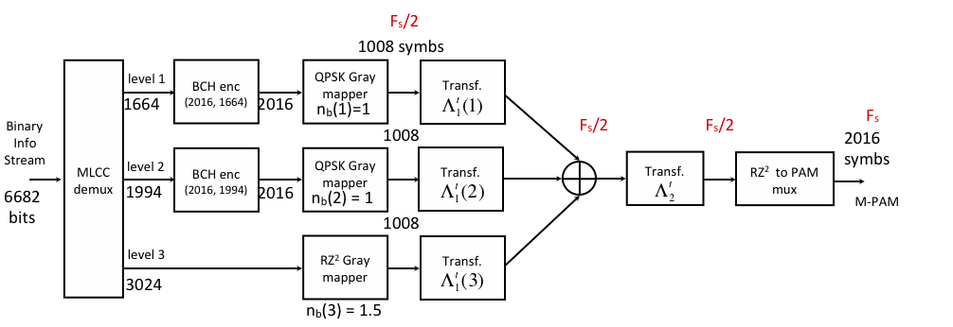
VDE encoding
MLCC with three levels based on BCH component codes
Low cost implementation
Low power implementation
Coding gain of 6.7dB @ BER 10⁻¹² with multi-stage hard decoding

Slide 28
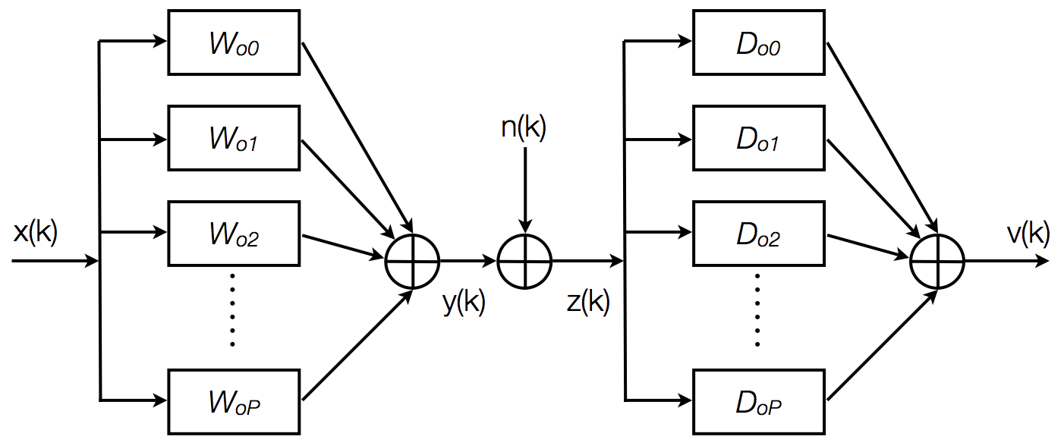
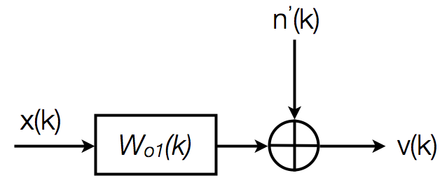
Non linearity
Driver + LED
POF
Photo-diode
TIA
Antialias Filter
POF non-linear channel
Linearized Channel
POF non-linear channel
Volterra’s series model
Linearizer
non-linear filtering

Slide 29
Non linearity - capacity penalty
Capacity loss < 1dB for
SNRe < 30 dB
High spectral efficiency schemes are feasible

Slide 30
VDE proposal performance
Sensitivity –19.0 dBm at output of the fiber for BER 10⁻¹² & 50 m. (Compromise between vendors)
Latency of 25 us
Overhead of Headers, Pilots and encapsulation: 3.5%
Multi-protocol encapsulation
Complexity:
50% of average 1000BASE-T implementation
Royalty free license LOA from KDPOF

Slide 31
Home Network market
Bandwidth requirements on the Home Network
WiFi & PLC limitations
Benefits of POF in the Home Network
Length requirements
POF installation examples
POF as backhaul
European Home Network study
Other Market examples
Conclusions

Slide 32
Bandwidth requirements on the home network
FTTH and other broadband access technologies offers increasing access speeds
Smart Home services is pushing the required Home Network speed beyond 100 Mbps
“All in the cloud”
VPN – remote working
4K video, multi-room DVR
high speed Internet, Internet of things…
Gigabit Ethernet assures the home network will not be a bottleneck

Slide 33
WiFi & PLC limitations
In many households (E.g., Europe, Latin America, etc.), neither Wi-Fi nor Power Line Communications (PLC) are able to provide high speeds with full house coverage
WiFi
Additional attenuation in brick houses over wooden ones is around 3.5dB per wall and 12 dB per floor. (ITU-R M.1225 Appendix 1 to annex 2)
WiFi channels are saturated in urban areas even with the new 5 GHz bands
PLC
Noisy PLC limits speed and robustness
Many ISPs stopped offering PLC due to unpredictable quality

Slide 34
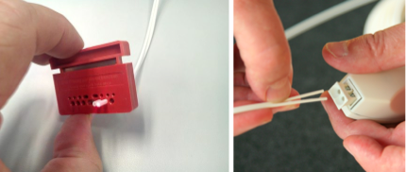
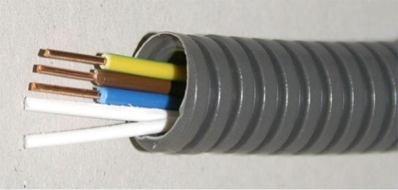
Benefits of POF in the Home Network
Easy to install
Low qualification or light training required
Connectorless option
Cut and plug
Electro Magnetic Immune, Galvanic secure
To be installed together with the mains
To be installed in houses with electrical noise problems
Flexible and robust

Slide 35
Length requirements in HN
50 m covers worst cases for:
Europe, Asia, Latin America and Africa
US and Canada
In big downtown areas, required lengths are similar to Europe ones
50 m covers most HN length requirements
What is a worst case is arguable

Slide 36
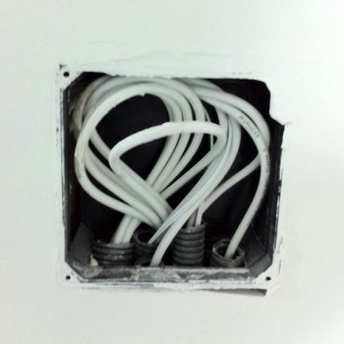
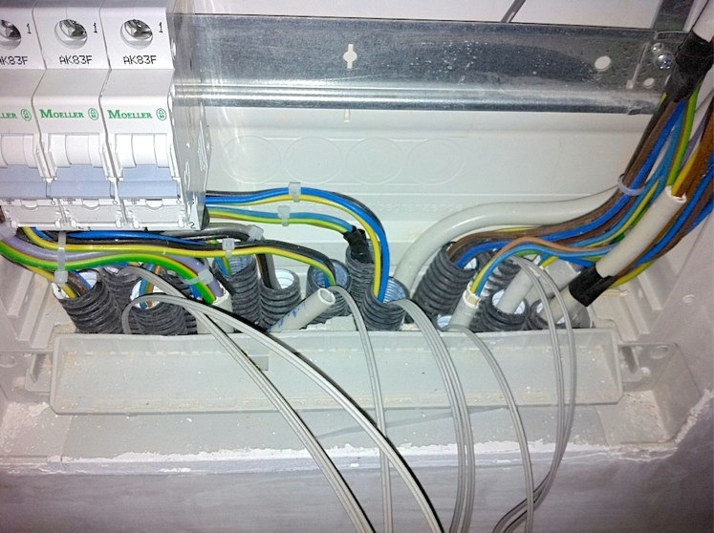
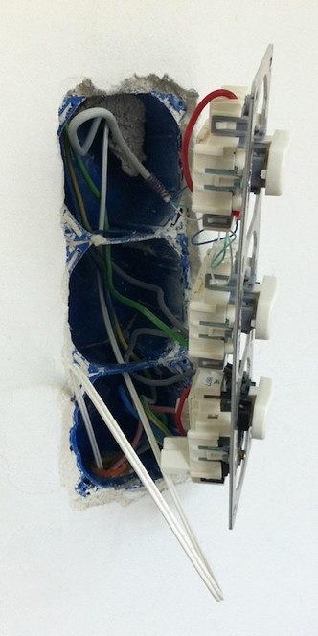
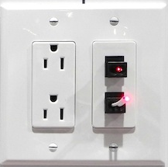
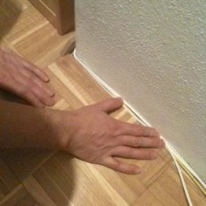
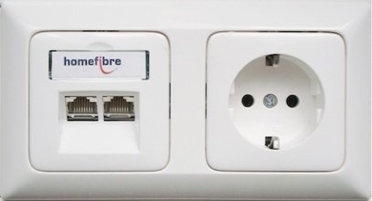
Examples of POF installation at home

Slide 37
POF as a backhaul interconnecting devices and WiFi AP´s
Optimal combinations of technologies: WiFi for mobility and Optical for broadband
Enables minimal power WiFi AP´s tailored to optimal room coverage: Less cross-talk and radiation
Distributes the broadband all over the home

Slide 38
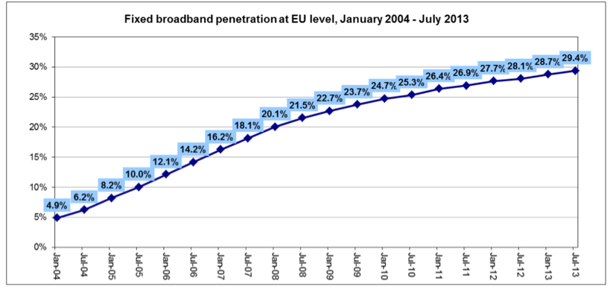
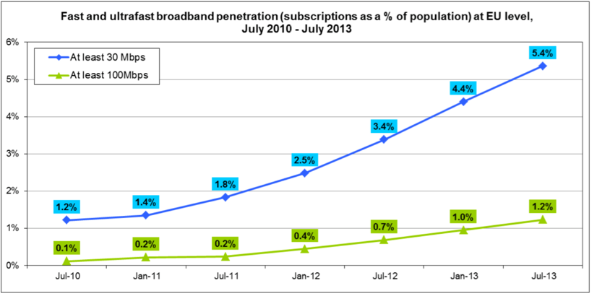
European home network study
What is happening in the Broadband Market in EU?
High growth of broadband connections
Which leads to greater capacity consumption
Which leads to greater speeds
This is also driven by the “multiscreen explosion” (increasing number of devices)
Data from “Broadband access in the EU: Situation at 1 July 2013”, on Tue, 25 Mar 2014

Slide 39
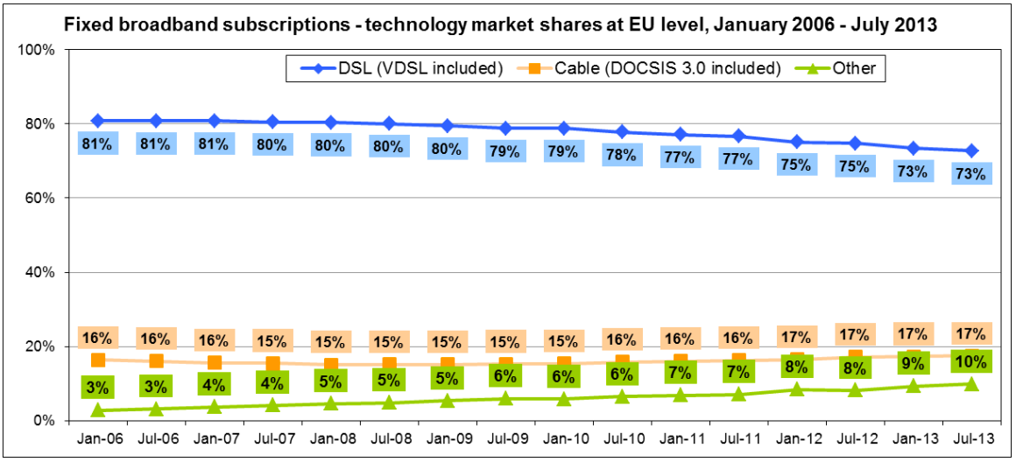
European home network study
Operators are investing heavily in deploying networks: DSL, Coax, FTTH.
Data from “Broadband access in the EU: Situation at 1 July 2013”, on Tue, 25 Mar 2014

Slide 40
European home network study
Ironically, the increase in nominal speed (beyond 20Mbps) is creating more dissatisfaction in some cases:
For Wi-Fi connections (most common), there are typically problems with speed , particularly in EU thick-wall housing
For PLC (sometimes used as an alternative by Operators), there are many interferences
For Ethernet Cat 5/6 (best current solution), the problem is often times resistance by house owners to outside wall cabling
Operators need to find an easy way to “match expectations” between what they sell and what the customer perceives.

Slide 41
European home network study
Telcos are typically finding several topologies for home networking in case of successful setup:
%cases(*) Cat5/6 Wifi
20% Router Wifi only - OK
20% Router Wifi + STB/PC in the same room OK OK
10% Router Wifi + STB/PC in the same room X⁽¹⁾ OK
25% Router Wifi + STB/PC in other room/s OK OK
15% Router Wifi + STB/PC in other room/s OK X⁽²⁾
10% Router Wifi + STB/PC in other room/s X⁽¹⁾ OK
STB = Set Top Box
1: Not OK, because of esthetical reasons
2: Not OK, because Wifi has difficulties in penetrating walls.
(*) Source: estimation by JAL21, based on industry reports and interviews.

Slide 42
European home network study
Telcos are typically finding several topologies for home networking in case of successful setup:
%cases(*) Cat5/6 Wifi
20% Router Wifi only - OK
20% Router Wifi + STB/PC in the same room OK OK
10% Router Wifi + STB/PC in the same room X⁽¹⁾ OK
25% Router Wifi + STB/PC in other room/s OK OK
15% Router Wifi + STB/PC in other room/s OK X⁽²⁾
10% Router Wifi + STB/PC in other room/s X⁽¹⁾ OK
STB = Set Top Box
1: Not OK, because of esthetical reasons
2: Not OK, because Wifi has difficulties in penetrating walls.
35% POF Opportunity (aprox).
(*) Source: estimation by JAL21, based on industry reports and interviews.

Slide 43
European home network study
POF opportunity in EU 2015 – 2020 is more than 15 mill. Households which represent approximately 60 million POF connections.
High Broadband Population penetration
20%
17,5%
14,4%
9,5%
11,2%
7,2%
5,8%
Total Population EU | 507.416.607 | 508.273.750 | 509.130.893 | 509.988.036 | 510.845.178 | 511.702.321 | 512.559.464
Total households EU | 219.203.974 | 219.574.260 | 219.944.546 | 220.314.831 | 220.685.117 | 221.055.403 | 221.425.689
Population HBB EU | 29.430.163 | 36.595.710 | 48.367.435 | 57.118.660 | 73.561.706 | 89.547.906 | 102.511.893
Households HBB EU | 12.713.831 | 15.809.347 | 20.894.732 | 24.675.261 | 31.778.657 | 38.684.695 | 44.285.138
POF Opportunity Households | 4.449.841 | 5.533.271 | 7.313.156 | 8.636.341 | 11.122.530 | 13.539.643 | 15.499.798
POF Opportunity connections | 17.799.364 | 22.133.084 | 29.252.624 | 34.545.364 | 44.490.120 | 54.158.572 | 61.999.192

Slide 44
Other HN market opportunities
European retrofit and new houses
3 M households per year
Latin America
New construction in Mexico, Chile, etc. requires low traning network installation
Japan

Slide 45
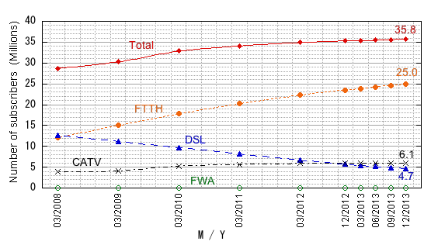
The Numbers of Fixed Broadband Access Service Systems Subscribers in Japan
Source: Japan Ministry of Internal Affairs and Communications
Broadband Access service spread widely in Japan

Slide 46
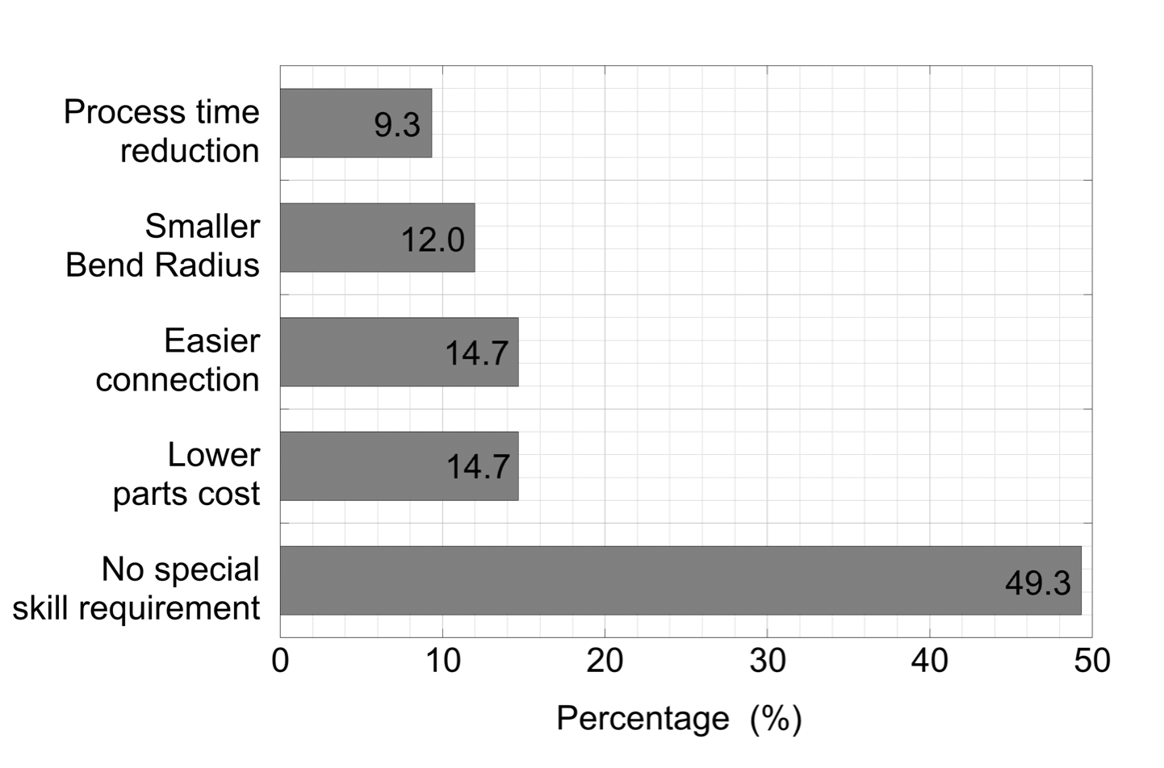
Japanese Survey for the demand of Optical Wiring
Answers from Building industries,
Wiring contractors, Home network users,
System vendors, Device vendors,
Cable manufactures and the others
In Japan
Great demand for
easy and no training
wiring

Slide 47
Conclusions
POF is an optimum media for Home Network backbone for many house construction types around the world
Easy to install
Can share the mains conduit
FTTH deployment, and new services requires a robust home network capable of handling new access bit rates
Copper is not usable in many old houses, where POF is usable

Slide 48
Automotive
Automotive networking
Market potential
JASPAR
O-GEAR Project
Open Alliance TC7

Slide 49


Automotive networking
Complements RTPGE/1000BASE-T1
Addresses those applications that can’t be serviced with 1000BASE-T1 UTP cabling
E.g., high electromagnetic noisy areas, galvanic isolation, long distances
POF is already used in automotive for information and entertainment with the MOST technology
Re-use of current MOST LED will guarantee automotive qualification
Leverages on already qualified connectors and cables
COAX
RTPGE UTP
STP
POF
Relative cost

Slide 50
Market potential
As stated in RTPGE CFI (March 2012)
Overall automotive Ethernet market up to 270 Million ports in 2019
Brings current automotive POF users to a fully seamless Ethernet solution
Stronger Ethernet automotive market potential growth
Complementarity use of RTPGE and Gigabit POF solutions
 | RTPGE | GIG-POF
Weight | ✓ | ✓✓
EMI/EMC | ✓ | ✓✓✓
Galvanic Isolation | ✓ | ✓✓✓
Temperature | ✓✓ | ✓
Length | ✓ | ✓✓
Cost | ✓✓ | ✓

Slide 51
JASPAR
One voice of JAPAN - JASPAR was established, in 2004, in order to pursue increasing development efficiency and ensuring reliability, by standardization and common use of electronic control system software and in-vehicle network which are advancing and complexing.
Next Generation High‐Speed Network WG
Chair: TOYOTA
Nissan, Honda, Denso, Renesas Electronics, Sumitomo Electric, Murata Manufacture, Toyoda Gosei, Clarion, Bosch Japan, NXP Japan, Micrel Japan, Yazaki, Furukawa Electric, Toyota Central R&D Labs, Marvell Japan, TE Connectivity, Nippon Seiki, Fujitsu TEN, Nippon Seiki, Isuzu Motor, Clarion, Mitsubishi Electric, Fujitsu Semiconductor, Toshiba Information Systems, Hitachi Automotive Systems, Calsonic Kansei, Micware, OTSL, Analog Devices, Vector Japan, ETAS, Marvell Japan, Sunny Giken, Telemotive AG, Ricoh, MegaGhips, Tokai Rika
Board: TOYOTA, Nissan, Honda,
DENSO, Toyota Tsusho Electronics
Members: Regular: 75 / Associate: 56 (as of Jan. ’14)
WGs:
Next Generation High-Speed Network WG
Functional Safety WG
AUTOSAR/FlexRay Standardization WG
Multimedia Architecture WG
Bluetooth Conformance WG
Mobile Device Interface WG
Requirements Definitions of the WG
Recommendation's application
Network
Function profiles
Physical layer and wiring design
Data description format

Slide 52
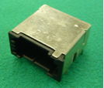
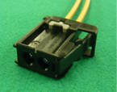
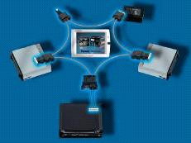
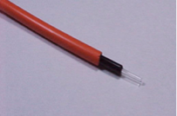
Optical Network Systems for Automotive
Optical Communication in Cars
Features of Optical Components
High speed
Scalability/Expandability
EMC/EMI
Dimensions
Weight
Small cable diameter
Small bending radius
Robustness
1980
1990
2000
2010
2020
Peer to peer
LAN
(POF)
D2B
IEEE1394
MOST 25
MOST 150
More than 100,000,000 nodes
More than 150 car models
Over 10 years
In-vehicle Optical Components
Cost Competition Strategy
No more measures against noise
Standardized test methods and components
Full automation manufacturing
Use proven technologies from other industries
Avoid price staging
Header
Connector
POF
Model link

Slide 53

International standardization and dissemination project for high-speed communication network performance over large core multimode optical fiber - Technology integration for O-GEAR: Optical Gigabit Ethernet for Automotive aRchitecture
From Oct. 2014 to Mar. 2017
No simulation tools of the system design for O-GEAR
No bandwidth guaranteed harness and connectors in high speed, 1 Gpbs - 10 Gbps
Required reliable system which target is similar to FlexRay, BER 10⁻¹²@10 Mbps
Problems
Team
Toyota Central R&D Labs.
Utsunomiya University
5 companies
AIST (a national institute)
6 companies
Assignment
Design Tool Development
Develop simulation tools for optical link system which include mode conversion function of mode power distribution in SI-MMF defined by EAF. Link system design will be achieved in simple and low cost.
Physical Layer Development
Develop physical layer components which have bandwidth guaranteed wire harness and connector at 1 to 10 Gbps followed by JasPar requirements and IEEE802.3 Stds. Create int’l standards in IEC and ISO.
System Demonstration
In order to achieve higher reliability network system, demonstration of BER 10⁻¹⁴ at 1 Gbps Ethernet for automotive is the key target. Such lower BER will be required for future autonomous driving system and ADAS.
Standardization
Promotion of Int’l Std.
De jure standards, IEC/ISO/IEEE, are required instead of traditional de-facto and OEM standards. Achieve low cost network systems with the use of international standardized components and systems.
OITDA (Project administrator)
9 companies
Sponsored by METI Japan

Slide 54
Schedule, In-vehicle Gigabit Ethernet
 | 2014 | 2015 | 2016 | 2017 | 2018 | 2019 | 2020 | 2021 | 2022 | 2023
Automotive
O-GEAR (Japan)
IEEE802.3 Ethernet for Automotive
1 G bps Car
1 G bps Cars
Product release
Development for mass production
1 G bps Demonstration
Support
Conformance Test Office
IEC/ISO Standards
1 G bps Ethernet Std.

Slide 55
Open Alliance – TC7
Open Alliance has created a Technical Committee to support the Ethernet optical links in automotive
Participants to this group are:
Avago, Broadcom, Cadence, C&S Delphi, Denso, Excelfore, Furukawa, KDPOF, Ruets, Sumitomo, TE, Toyota, Vittese, Yazaki
Goal of the group is: “Work on Gigabit‐Ethernet over POF solution for Automotive use”
Summarize Automotive requirements and support IEEE802.3 GEPOF standardization activity.
Create supplement documents/ Specifications (Connector interface, Footprint, test suits, etc.) for automobile installation

Slide 56
Summary for Automotive Applications
Complementary technologies, electrical and optical, bring benefits for customers
Plastic optical fiber is a proven technology in automotive
Gigabit Ethernet enhances future applications
Member companies from JASPAR contributes to the standardization works

Slide 57
Industrial market
Overview of industrial POF fibers
Evolution of POF based industrial Automation Network Systems
Environmental conditions
Factors of success of POF in industrial networking
Mechanical characteristics of POF
Industrial Example
How to terminate POF with an industrial connector
Conclusions

Slide 58

Overview of industrial fibers
 | Polymer Optical Fiber | Hard Cladded Silica | Multimode | Singlemode
Shortform | POF | PCF | GOF-MM | GOF-SM
Standard IEC 60793-2 | A4a | A3c | A1a/ A1b | B1
Absorption [db/km] with λ [nm] | 230 660 | 6 850 | 3,0/ 3,5 850 | 0,5 1300
Core diameter [μm] | 980 | 200 | 50/ 62,5 | 9
POF
PCF
GOF-MM
GOF-SM
best optical solution for short distances POF easy termination

Slide 59







Evolution of POF based Industrial Automation Network Systems
data rate
Industrial Gbit Ethernet
Needed and wish from the industry
1GBit/s
POF 50m
100MBit/s
Industrial Ethernet
POF 50m
Fieldbus
Volume is 1Mio nodes per year
~10MBit/s
POF 70m
~1990
~2000
~2015
time
Fieldbus e.g. | ControlNet™
Industrial Ethernet e.g.
Industrial communication systems are successfully using POF since more than 20 years.

Slide 60



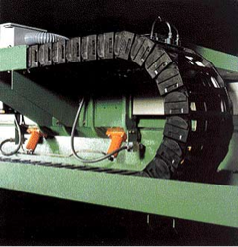

Environmental conditions
commercial: industrial:
MICE | 1 = Commercial environment covered by IEC 11801 | 2 = Light industrial environment | 3 = Heavy industrial environment
Mechanical | M₁ | M₂ | M₃
Ingress | I₁ | I₂ | I₃
Chemical | C₁ | C₂ | C₃
EMC | E₁ | E₂ | E₃
Three alternatives:
reinforce, e.g. with IP67-components ⇨ the trend with local automation
Isolation, e.g. with housings
seperation, e.g. in seperatet rooms
Tough solutions are required in Industrial applications!

Slide 61
Factors of success of POF in Industrial Networking
Industrial Networking requires:
EMC-resistant systems
Environment-resistant systems
Galvanic isolation
Easy wiring
Easy field termination
Easy planning
POF fulfills the requirements for Industrial applications

Slide 62
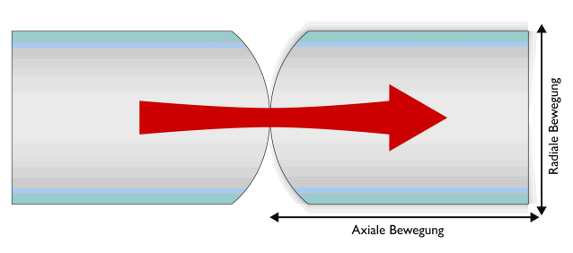
Mechanical Characteristics of POF
radial movement
axial movement
Fiber displacement caused by:
Shock, Vibration and Temperature
Fiber displacement results in slightly higher attenuation but no loss of connection
e.g. Radial fber displacement of 100µm would result in a link down for 62.5µm MM fiber but has only a minor attenuation impact to a POF link
POF has excellent bending and torsion properties. Tests have shown that the POF can withstand more than 1000k bending and torsion cycles
POF has mechanical advantages due to the large diameter and material

Slide 63

Example robot cell in automotive industry
Cable length from the robot to the control cabinet typically 20 m
Welding tools and drives cause EMC-troubles
Rough environment
Field cable termination necessary
Data- and power cable very close
Low weight
Bending/torsion durability of POF
Monitoring of link quality
POF fulfills the requirements perfectly

Slide 64
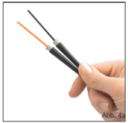
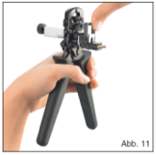
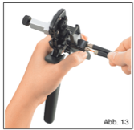
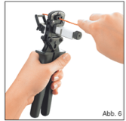

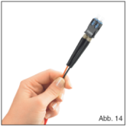
Termination of POF-Connectors
Remove cable coating
Pulling boot over wire
Cut the fiber
Remove isolation
Fix connector in the intake
Put wires in the boot
Tighten the screws
Done!
Attenuation max. 1,5 dB Fast and easy
Reliable process Field termination possible

Slide 65
Conclusion
Industrial technology has:
Applications with short link distance
Industrial requires:
Robust solutions in respect of EMC and harsh environment
Galvanic isolation
Easy field cable termination
Easy rules
POF is the best choice for communication systems in Industrial networking

Slide 66
SUMMARY

Slide 67
Summary
Three target markets have different: link length, number of connectors, and environmental constraints
All three markets can be addressed by a single PHY
Link budget allows for tradeoff of market constraints (e.g., fewer connectors for longer length)
Royalty Free IEEE LOA from KDPOF
Covers technology adopted by VDE project if selected by TF
IEEE 802.3 is a global standard
We need to address global requirements
Not all markets have similar opportunities
Users and vendors throughout the supply chain want an 802.3 GEPOF standard

Slide 68
Future of POF
LENGTH
GEPOF+ GREEN
10000 POF
100m -
GREEN Light source
50m -
100FX
over POF
GEPOF
MOST-25
MOST-150
Maybe GI-POF Maybe VCSEL
15m -
25 Mbps -
150 Mbps -
100 Mbps -
1000 Mbps -
10000 Mbps -
SPEED

Slide 69
SUPPORT
Support
Quotes

Slide 70















Support
Some of the companies encouraging IEEE 802.3 to develop GEPOF:
Home Network

Slide 71










Support
Some of the companies encouraging IEEE 802.3 to develop GEPOF:
Automotive

Slide 72














Support
Some of the companies encouraging IEEE 802.3 to develop GEPOF:
Industrial and others

Slide 73
Quotes
"The in-vehicle gigabit network will definitely be essential in the near future. Automobiles are vulnerable to noise, which is difficult to solve even with electric cables, especially in the Gigabit Ethernet. Thus, it is better to prepare a backup solution and I look forward to optical network standardization. However, cost reduction is a key factor for practical use in the automotive market; therefore, I hope everything goes well." Hideki Goto - Group Manager, Toyota Motor Corporation
"Gigabit over POF utilises proven Physical Layer components and harness assembly procedures that are well understood by the automotive industry. For this reason, JLR believe, that such a standardised technology could offer a potentially fast time to market for certain use cases of gigabit Ethernet within the vehicle cabin.” John Leslie - Communication Systems Technical Specialist, Jaguar Land Rover Limited

Slide 74
Quotes
“… the only way to match expectations between the broadband speed we sell and what the customer perceives it´s the cable. I think POF is a great cable solution.” Mario Diaz - Director for Home Fiber and broadband Offering, Telefonica
“Vodafone, sees that POF is an easy way to "match expectations” between the broadband speed that we sell and what the customer perceives, potentially avoiding many problems with Wifi connections (and other problems in home networking) in a cost-effective way.” Juan Manuel Sánchez – Managing Director Vodafone Spain
‘‘In this market, engineers are already using FPGAs to run high speed links with their own protocols for a variety of industrial networking applications over POF. (…) In the telecommunications world companies such as Orange, Telecom Italia, and Swisscom for example have completed trials validating the business case for POF but to move the solution forward they need a GigE solution as GigE is now the technical base line. (…) It would be a cleaner solution if that usage were to a published standard ensuring interoperability and a level commercial playing field and benefiting from the robustness that an IEEE standard provides.’’ - Michael O’Gorman VP Marketing Firecomms

Slide 75
QUESTIONS

Slide 76
BACKUP SLIDES
Optical model for SI-POF

Slide 77
Optical model for SI-POF
Power flow equation (Gogle’s eq.):
P is the optical power distribution in time instant (t), fiber length (z), propagation inner angle respect to fiber axis (θ) and wavelength (λ)
α is the Differential Mode Attenuation (DMA)
τ is the Relative Mode Delay (RMD)
Initial conditions (launching conditions):
Boundary conditions to solve PDE:
Mode mixing
Differential mode delay
Relative mode delay

Slide 78
Optical model for SI-POF
The DMA from steady state Far Field Pattern (FFP) Q(θ) as*:
γ(λ): characteristic attenuation of POF as function of wavelength
Q may be fitted by bi-sigmoid function*:
The RMD is given by:
c is the vacuum light speed, ncore is the refractive index of core
The diffusion coefficient may be fitted by:
(*) Mateo et al., “Global characterization of optical power propagation in step-index plastic optical fibers”, Vol. 14, No. 20, OSA (2006)

Slide 79
Optical model for SI-POF
Impulse response of SI-POF, including modal and chromatic dispersion:
where SPD is the sensitivity of photo-detector and ηPD is the directivity

Slide 80
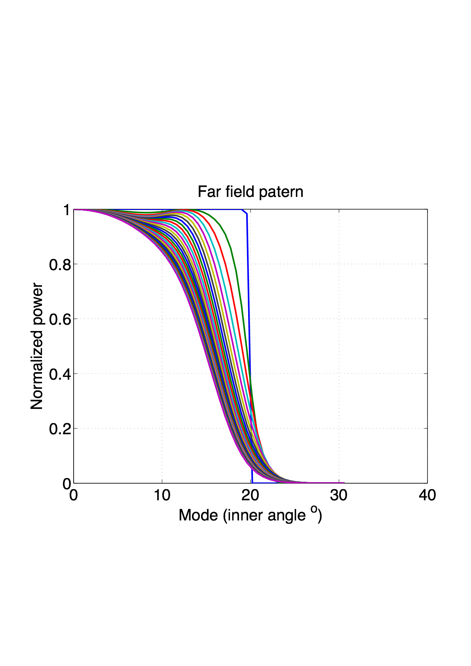
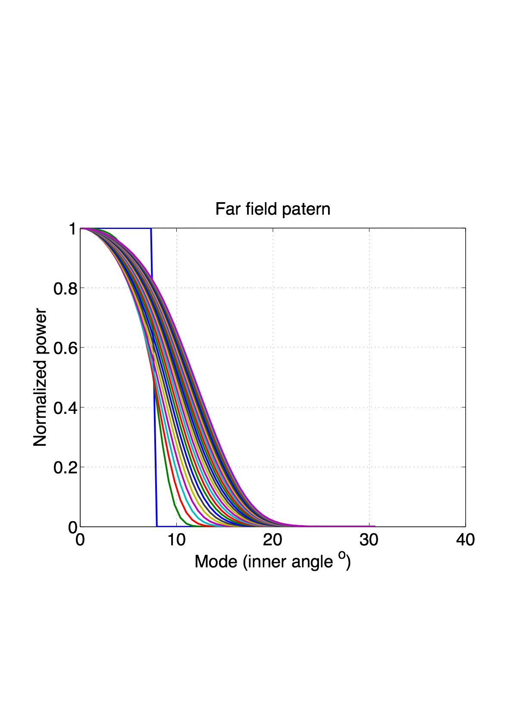
Introduction to POF - mode mixing
Uniform Mode Distribution (UMD)
FFP for
over-filled launching condition
FFP for
under-filled launching condition
Launching UMD 0.5
Launching UMD 0.2
⬆︎ length 0 to 100 m
(mode mixing)
EMD
⬆︎ length 0 to 100 m
(mode mixing)
EMD

Slide 81
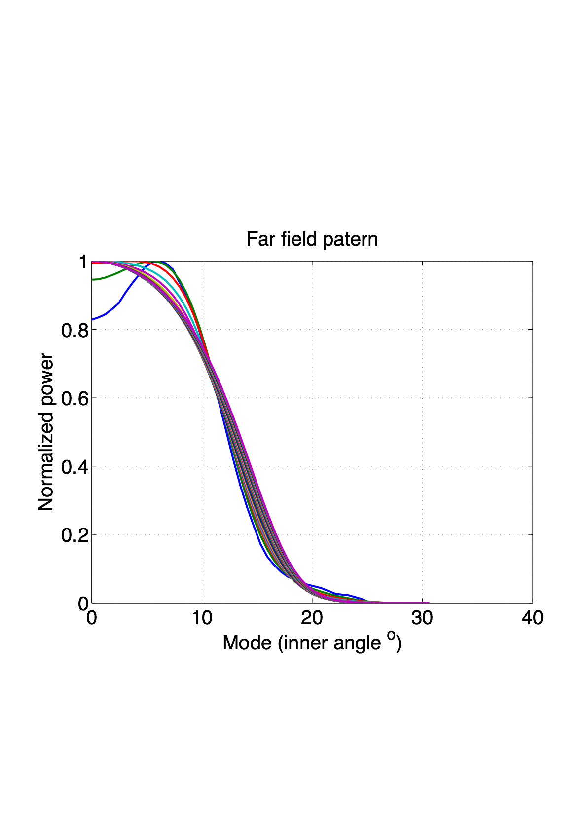
Introduction to POF - mode mixing
Real LED with almost EMD condition
FFP for
EMD launching condition
LED + lens
launching MD
⬆︎ length
almost equal mode distribution

Slide 82
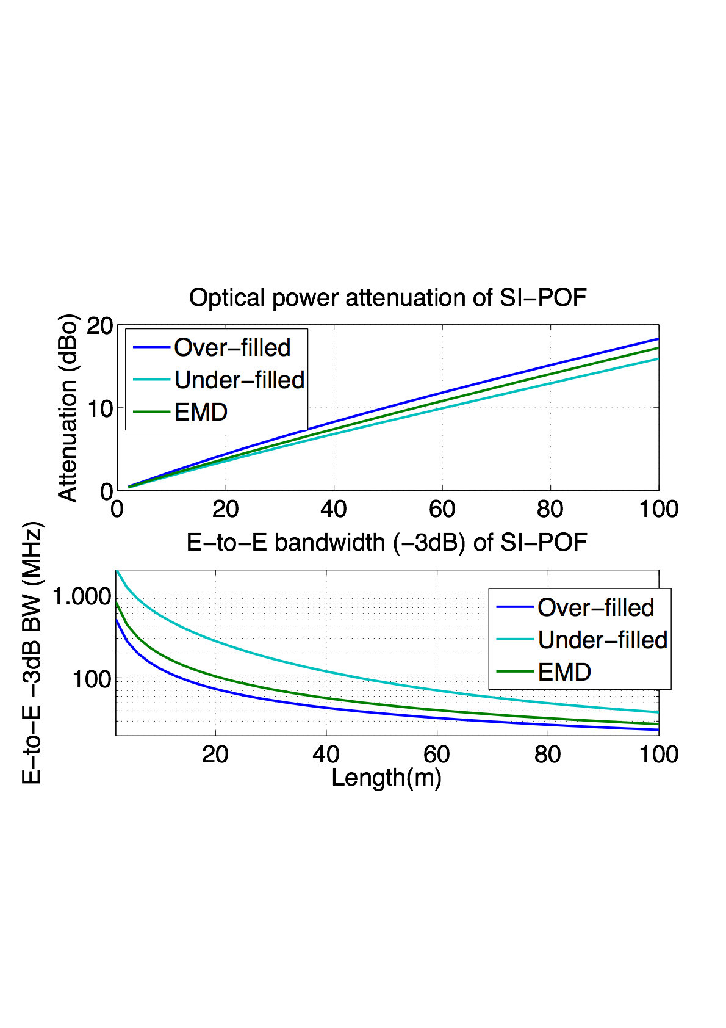
Effect of mode mixing in Attenuation and Bandwidth

